Slide 1
WHA Information Center (WHAIC): ASC Tools for Everyday Use
Jennifer Mueller, MBA, RHIA, SHIMSS, FACHE, FAHIMA
Vice President, Privacy Officer
Notes:
Good morning and thank you for inviting me to present on all things “data” and the WHA Information Center. My name is Jennifer Mueller and I'm the vice president and privacy officer at the Information Center. I've been with the organization for about four years. Prior to this role I worked as vice president and chief information officer at Watertown regional medical center in Watertown WI for about 20 years.

Slide 2
Agenda
WHAIC: About Us
Claims data collected (and data not collected)
Survey data collected
WHAIC Data uses and analytics: ASC specific
Getting Value from ASC Data
Notes:
So here is our agenda for the time that we have with you this morning . We would like to start with a little icebreaker so we can get a feel of your experience working with healthcare data. We will move into talking about healthcare data and where you can find it and some general uses of it. Then I will share information about us at the WHA Information Center specifically, I want to go over the claims and other data that we collect as well as how we use that data in our analytic tools and other web applications . And then finally we will dive into our interactive visualization tool called Kaavio. Derek and Brian will run through some real-life use cases with you using that tool to wrap up the morning.

Slide 3
The WHAIC Team
Brian
Cindy
Jennifer
Heather
Steve
Janice
Derek
Justin
Seth
Amber
Emily
Notes:
This is my great team! We are a small but mighty group! I have been at the Information Center for the past 4 ½ years. Prior to this position I was the Vice President of Ancillary Services and Chief Information Officer at Watertown Regional Medical Center for 20 years. Brian is our Director of Operations and has been here since the start of the Information Center, Cindy and Heather are responsible for all of our data collection, Steve does our database work, our publications and custom data requests, Alistair is our data analyst, manages our CheckPoint website and is our quality liaison, Janice is responsible for the build and maintenance of all of our websites and internal applications, Derek does all of our visualizations and dashboards in Tableau, Patrick is our IT system administrator, Seth is our Information Security Officer and Emily is our newest staff member who does some analytics, visualization builds and other duties as assigned ☺.

Slide 4
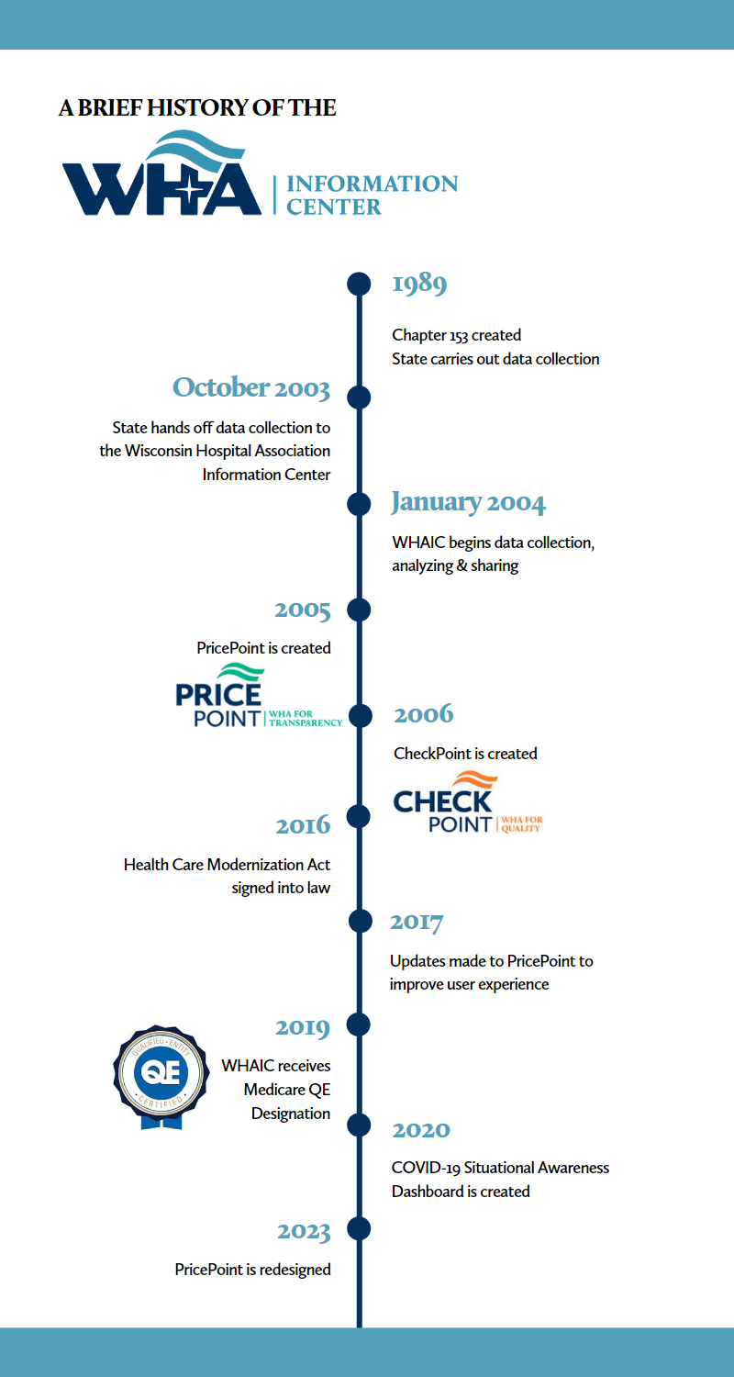
About Us: WHA Information Center
WHA Information Center (WHAIC) is wholly owned subsidiary of the Wisconsin Hospital Association.
Notes:
The WHA Information Center is a wholly owned subsidiary of WHA. WHA and the WHA Information Center have been partners with DHS for a long time in the collection and sharing of discharge and claims data from Wisconsin hospitals and Ambulatory Surgery Centers under Chapter 153 of the Wisconsin statutes. As a matter of fact, in 2003, WHA worked closely with Governor Doyle to create a contract between WHA and DHS and the Information Center has been under contract with the Department of Administration since then to lead the State’s data collection efforts. Since that time, the Information Center has brought up two transparency websites…PricePoint for price transparency and CheckPoint for quality transparency. Another significant milestone was the passage of the Healthcare Modernization Act in 2016, which now permits the Information Center to collect patient address data which allow us to convert it to the census block group level which enhances mapping functionality in our visualization software. More recently, in late 2019, the Information Center received notice from CMS that we had received designation as a Qualified Entity. Actually, the first, and only, hospital association in the country to receive this status. Being recognized as a Qualified Entity will allow us obtain the Medicare FFS claims data directly from CMS to allow us to do more advanced data analysis and reporting on non-hospital data. Finally, due to the COVID-19 pandemic, the Information Center, in collaboration with DHS, developed the COVID-19 Situational Awareness dashboard in early 2020.

Slide 5
Information Center Data
Discharge/Claim Data Collected
Annual Survey Data/Collected
How the Data is Used
Annual Survey of Hospitals
Hospital Fiscal Survey
Medicare Cost Report (wksht C)
Personnel Survey
Uncompensated Health Care Survey
Hospital Rate Increases
Publications (Mandate)
Guide to Wisconsin Hospitals
Health Care Data Report
Uncompensated Health Care in Wisconsin Hospitals
Hospital Rate Increases
Workforce Analysis & Predictions
Quality Report/Quality Improvement
Readmission rates
Potentially Preventable Readmissions
Hospital Acquired Conditions penalties
Other specific adverse events
Analytics
Kaavio
PricePoint
CheckPoint
Other analytics/custom requests
Hospital discharge claims (153)
Ambulatory Surgery Centers (80)
Quarterly data submission/collection (3,000,000 records/qtr)
Data not collected
Professional/clinic:
Pharmacy
DME
Nursing facilities
Notes:
The Information Center, receives discharge data from every Wisconsin Hospital, of which there are 163 in the State, and every one of the 68 Ambulatory Surgery Centers. The data collection is done on a quarterly basis in the amount of almost 3,000,000 records per quarter! This is patient level claims data…which includes such information as patient demographics, diagnoses codes, procedure codes, dates of service, place of service, payor information…just to name a few. In addition to this, the Information Center collects data via several annual surveys…the Annual survey, Fiscal survey, Medicare Cost Report, Personnel survey and Uncompensated Care survey. From there, all of this data (both claims data and survey data) serve as a foundation for the creation of several publications which are mandated by Chapter 153 and are ultimately are made available to the public on our website. One publication example is the Guide to Wisconsin hospitals which uses information from the Annual AND Fiscal surveys and provides detail about each hospital in Wisconsin related to utilization, service, staffing and finance. We also utilize the data collected and partner with the subject matter experts at WHA to create other annual reports like the Workforce Report and the Quality Report. These reports serve to both provide an analysis of the respective data, as well as to offer real life examples to serve as best practices. And finally, the Information Center utilizes this data to populate its data analytic and visualization tool called Kaavio, both transparency websites (PricePoint and CheckPoint) and to fulfill other custom requests as needed.
_____________________________________________________________________________________more info below should anyone ask…
The Guide to Wisconsin Hospitals provides detailed staffing, utilization, and financial information from data submitted by Wisconsin hospitals. It is based on the Annual Survey of Hospitals and the Hospital Fiscal Survey. Detailed averages are shown for individual hospitals in tables that list selected measures of finance, service, staffing and utilization. Averages are also shown for selected groups of hospitals and for totals across the state.
The Hospital Quality Indicator Report: users now directed to CheckPoint
The Health Care Data Report provides information on utilization and charges at hospitals and freestanding ambulatory surgery centers.
The Uncompensated Health Care in Wisconsin Hospitals provides charges for charity care and bad debt and number of patients receiving uncompensated health care services. It is based on the Hospital Fiscal Survey.
Wisconsin hospitals are required to report Hospital Rate Increases to WHAIC. When a price increase causes a hospital’s gross patient revenue to increase faster than the rate of inflation (specifically, the increase in federal government’s consumer price index, or CPI), the hospital must report the price increase to its community and WHAIC.
The personnel survey is what we collect from the hospitals. This survey collects additional workforce data than the annual survey to better track and understand the workforce issues that affect Wisconsin hospitals.
Some of the questions ask (by category):
- Number of positions that are vacant and are actively being recruited.
- Number of employees over 55
- Number of employee separations
We do not collect the Nursing Workforce survey. We request access to it from Department of Workforce Development (DWD) so that we may do some analytics on it. These are surveys that nurses complete themselves every other year.
Some items asked:
- looking at education levels
- are they currently employed
- what setting are they working in
- currently enrolled in a BSN or masters program, or plan to pursue further

Slide 6
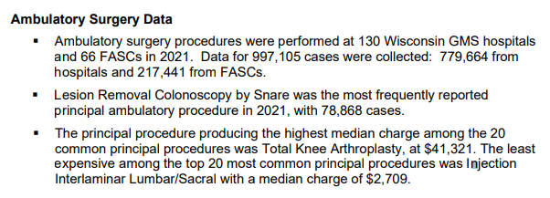
WHAIC Publications
Notes:
ASCs would find our Health Care Data Reports most useful. Data were collected on all ambulatory surgery procedures performed in hospital-based outpatient surgery units and Medicare-certified FASCs. There are several breakdowns of the data including GMS Hospitals and ASCs by top 20 most frequently performed principal procedure. I think you’ll find a lot of great information in this report. We are currently collecting data for 2022.

Slide 7
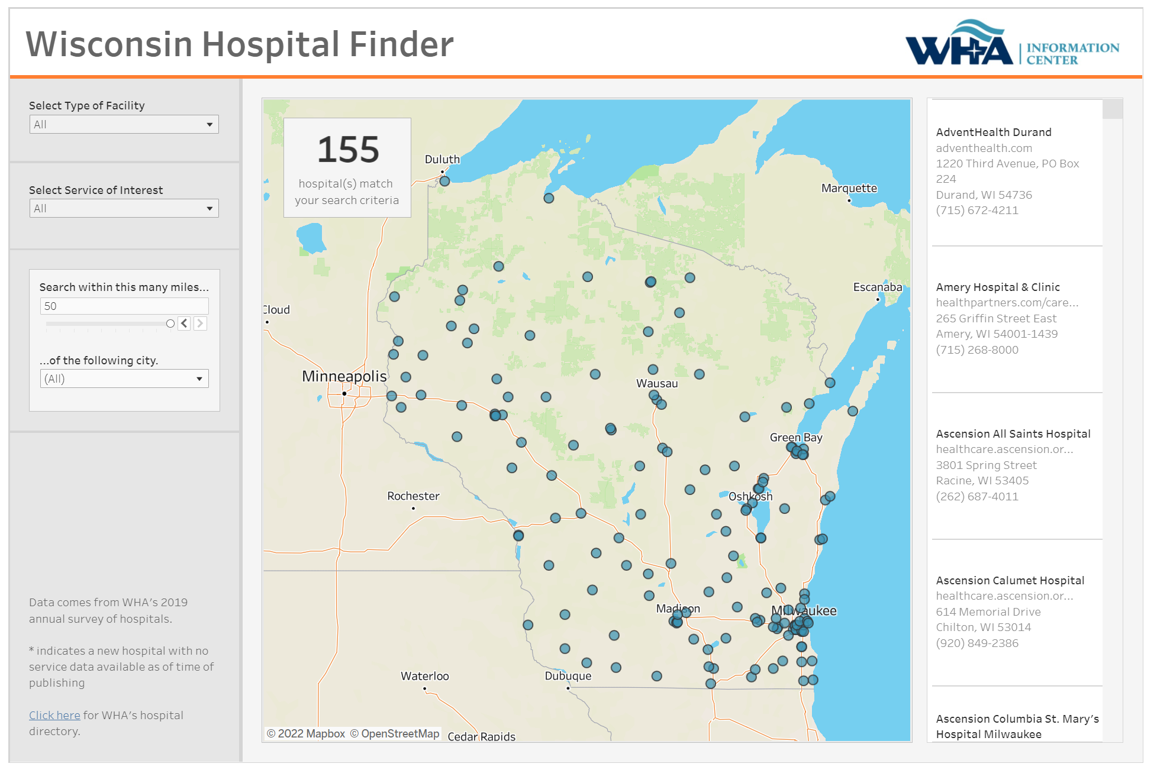
Hospital Finder
Notes:
(I thought useful to add for ASCs so they know about this tool in case they need to locate a hospital service for one of their patients) Another example of how we use all of the data we collect is in our new hospital finder tool. Instead of a static list of hospitals on our website, we created this very informative interactive map. The WHA hospital finder tool draws upon information collected in our annual survey of our members.

Slide 8
Who Uses the IC Data?
Data Uses
84% of Wisconsin hospitals purchase data sets and/or custom data sets/reports from WHAIC.
23% of ASCs purchase data sets and/or custom data sets/reports from WHAIC
Other purchasers of custom data sets and/or reports include Insurers, Researchers and Universities.
Data is used for Price and Quality Transparency (PricePoint & CheckPoint)
Analytics
WHAIC’s data analytics tool (Kaavio) is provided at no charge to hospitals that purchase the data at the required level.
Users: 190
Hospitals: 113
ASCs: 20
WHAIC and the Wisconsin Office of Rural Health (WIORH) offer the Rural Health Dashboard (RHD) as a way rural hospitals can use their SHIP program funding (Small Rural Hospital Improvement Grant).
There are 18 hospitals participating in 2022-2023.
The RHD consists of eleven (11) executive-level dashboards
Dashboards:
COVID-19 Situational Awareness Dashboard
Others…
Notes:
The hospital and ASC discharge data that are collected and shared by the Information Center, provides Wisconsin hospitals and other stakeholders, a solid foundation for analysis. Currently, 84% of Wisconsin hospitals purchase this discharge data from the Information Center. In addition, the Information Center has several other purchasers of custom data sets or custom reports. These include insurers, researchers and universities. As stated previously, the data is also used to populate PricePoint and CheckPoint. The WHA Information Center also provides data and analytics services to support WHA’s quality improvement initiatives. 113 hospitals and 190 users rely on the Information Center‘s data analytics and visualization tool, called Kaavio, to analyze the data. In addition, for the past six years, we have partnered with the Wisconsin Office of Rural Health to provide Kaavio, and eleven executive level dashboards to rural hospitals in Wisconsin through their use of their Small Rural Hospital Improvement Grant money. There are 13 hospitals participating this year. And finally, our data is used to inform the public, our health care partners and legislators through the use of dashboards. One example of this type of dashboard is the WHA COVID19 Situational Awareness Dashboard.

Slide 9
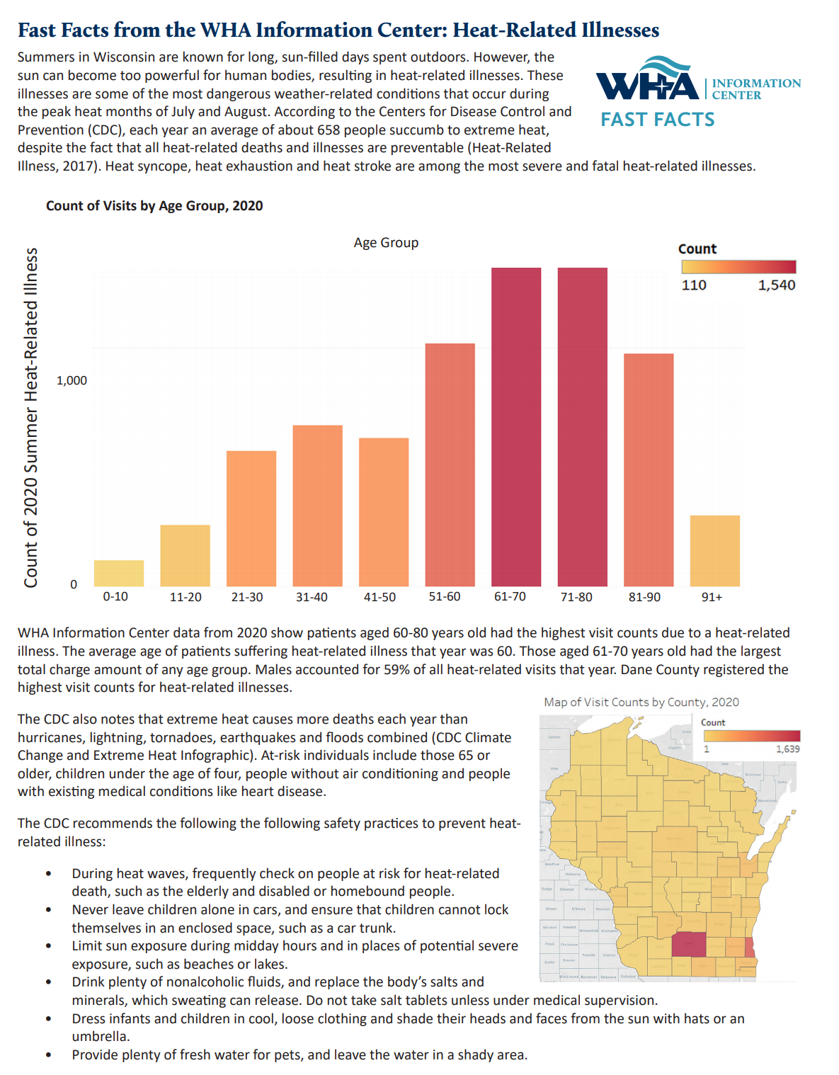
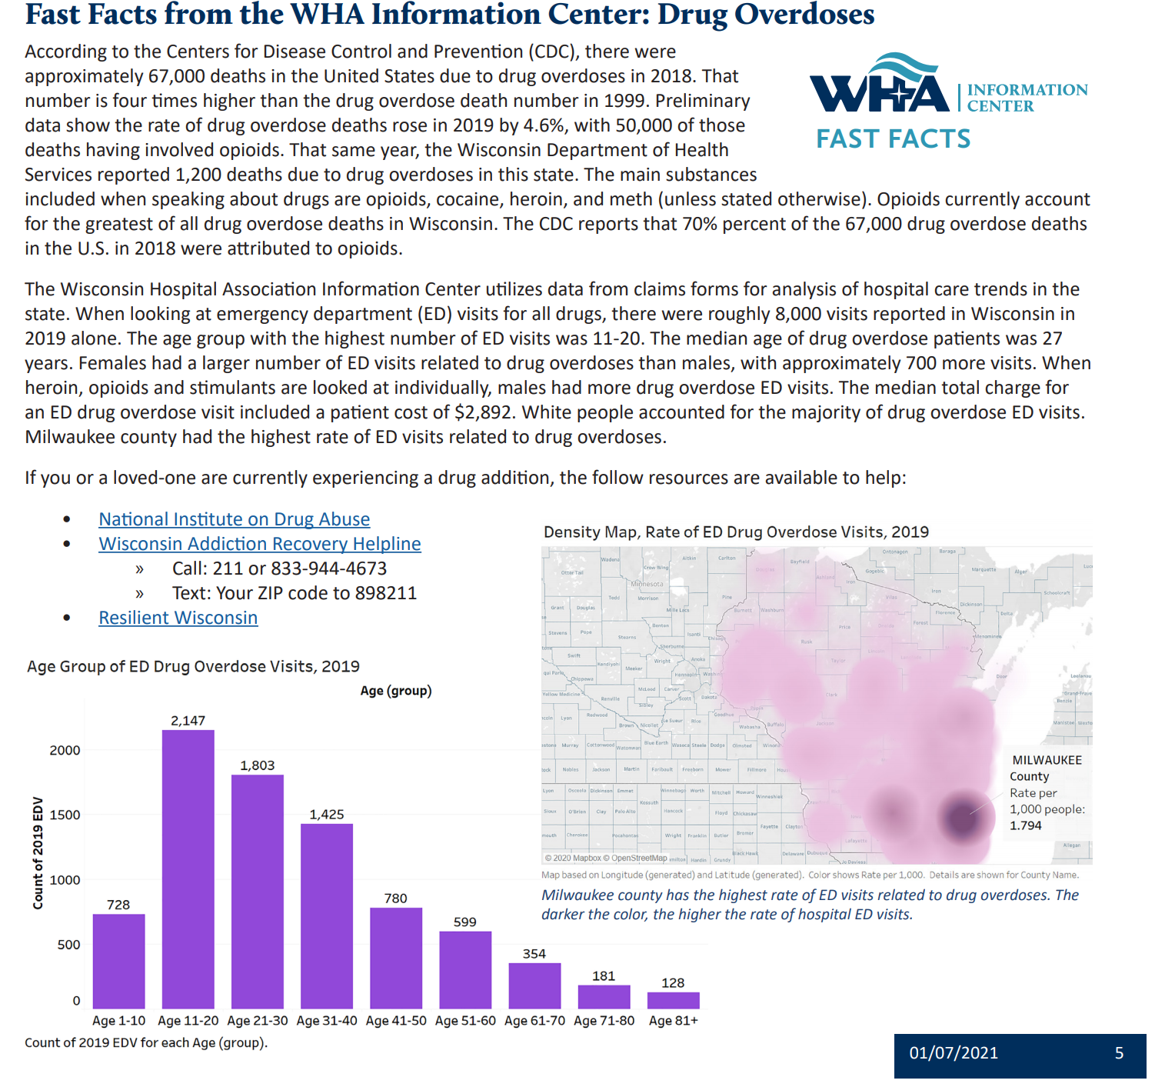
Fast Facts: Do you have suggestions?
Notes:
One way the Information Center uses the data collected under chapter 153 is through the publication of our Monthly “Fast Facts” which are published in the WHA Valued Voice Newsletter. These are short snippets of information from the data, focused on a certain diagnosis or condition which affect many people. We include relevant text and a few visualizations to enhance the points by making them interesting and eye catching, as well as demonstrating the abilities of the Information Center. If you do not currently receive WHA’s weekly newsletter, I highly suggest signing up for it. It comes out on Thursday afternoons and is full of great information around the advocacy work being done, upcoming educational events and other information about hospitals in the state, regulations being discussed and of course, we try to include some data pieces every now and then. To sign up just go out to the WHA.org website under media room, newsletters and there will be a bright orange button there you would click to sign up.

Slide 10
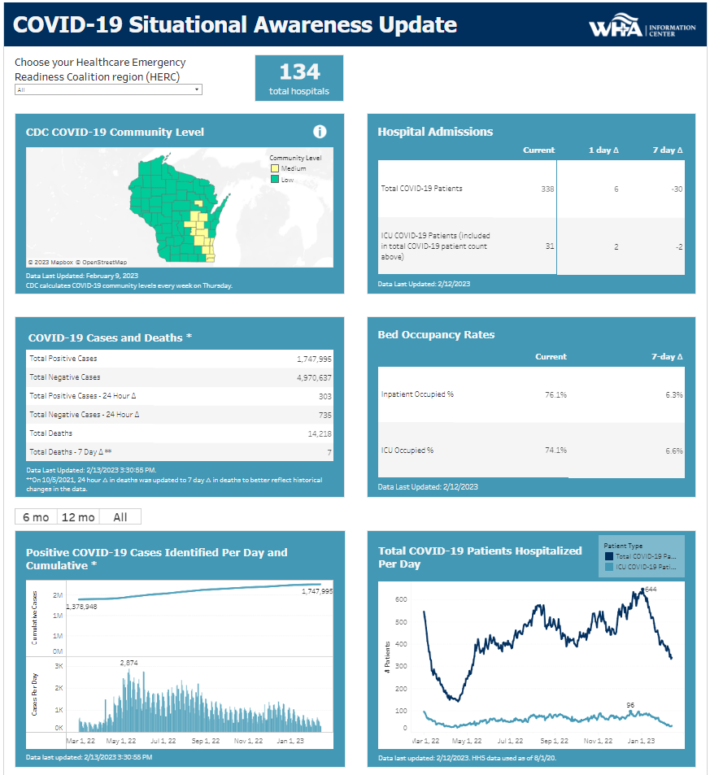
WHA COVID19 Dashboard
Notes:
Here is where we start talking about how the IC has taken various data sources and turned them into valuable and actionable information. This is the COVID19 Dashboard. I imagine that most of you have seen this on the WHA website. The information center developed this back in April 2020 to help policymakers and other key constituents better understand the impact of the COVID-19 pandemic in Wisconsin. We worked collaboratively with the state’s Department of Health Services to obtain the data from information received by the state’s seven Healthcare Emergency Readiness Coalitions (HERCs) and COVID-19 case-related data from DHS. The dashboard shows information related to hospital admissions and bed count, available ventilators and the number of hospitals with seven days or fewer supplies of personal protective equipment (PPE). The dashboard is updated on weekdays, it’s interactive, with the ability to display both statewide data and those of individual Healthcare Emergency Readiness Coalitions or HERC Regions. We continually incorporate feedback to improve our data tools so they are informative and useful to the end users. To that end, we added a 7-day moving average to help smooth out trends. And, in an effort to “declutter” the trend graphs, we added filters to display less data. This dashboard has received almost 1.5 million page views to date!

Slide 11
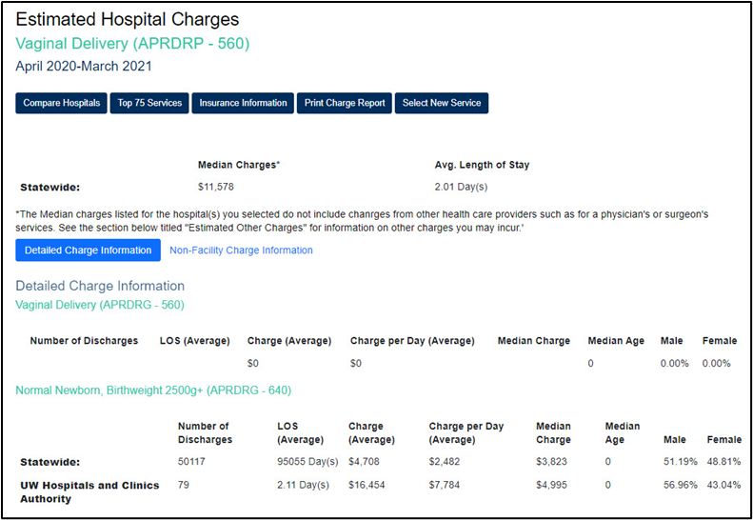
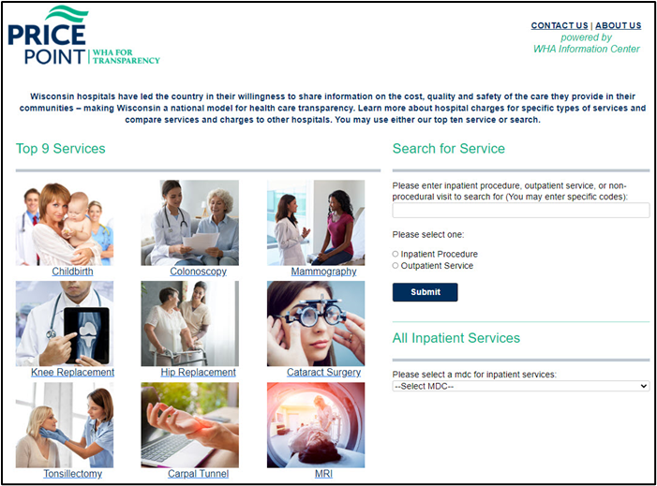
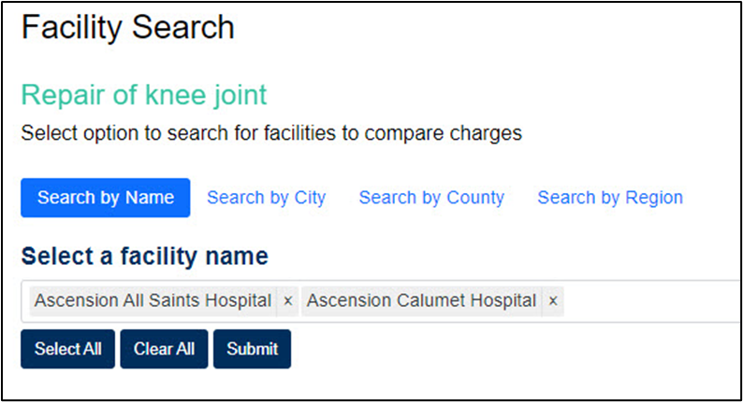
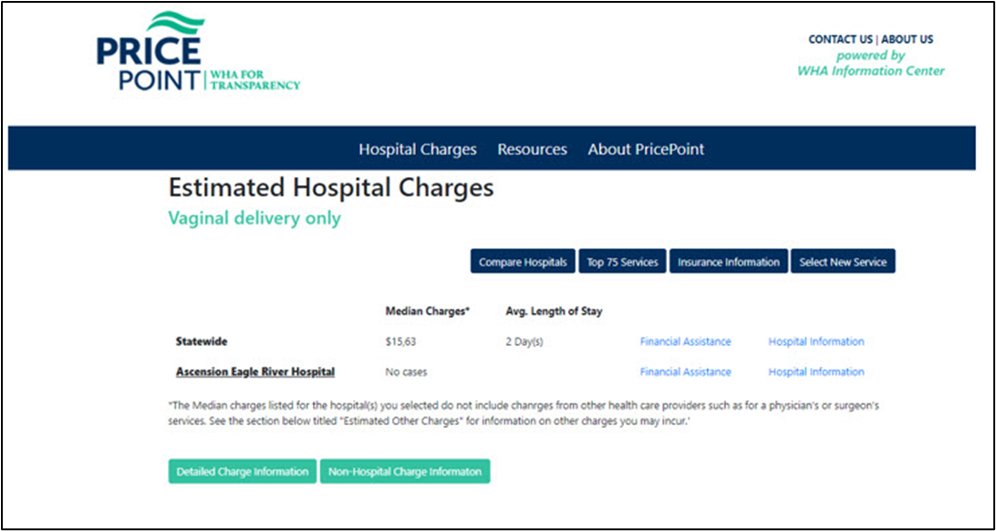
Transparency: PricePoint
Notes:
Another example is our PricePoint.org consumer facing website. Since 2005, WHAIC’s PricePoint website has been providing patients and families with important information about health care services and charges in Wisconsin. It has truly become a national model for price transparency as we currently host PricePoint for 3 other states. We have begun the work to redesign this website as well with the completion goal first quarter 2022. In order to improve the user interface, we have partnered with a company called IMO or (Intelligent Medical Objects), which allows the user to simply enter a procedure term (like colonoscopy) in a google like search bar and through mapping in the background the application will return the applicable charges and other information.
But for now, I’m going to walk you through the existing site so you can get a feel for the type of information it provides. Since people have high deductibles and may shop more for their care, PricePoint is a great place to start. While it won’t give you exactly what you are financially responsible for it will at least give you a start. So let’s walk through a scenario.

Slide 12
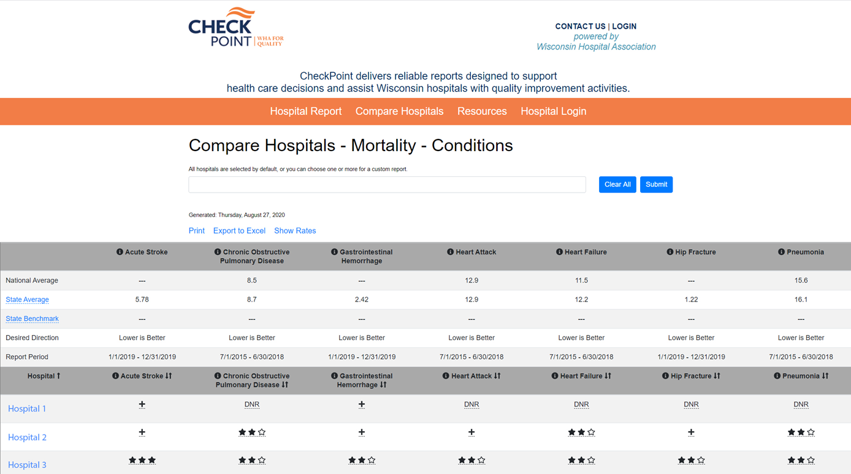
Website Redesign: CheckPoint 4.0
Notes:
The role of health care data – especially data that is transparent, publicly available and actionable is a key driver for quality improvement. CheckPoint, which is our consumer facing, quality transparency website, was developed back in 2006 and desperately needed to be redesigned…the front end AND the back end. So we’ve recently updated the platform to be more responsive and to improve the user experience. There are now fewer clicks to get to what users want, and similar measures are now reported together as families. For example, infections were spread across five reports and are now together. We have standardized content management where basically we are using the same tool as our other public-facing sites. This site went live at the end of 2020. We host this site for South Carolina and Wyoming as well so we are looking forward to converting them soon as well. This is a great site to go out to and check quality scores for certain procedures for a hospital…you can compare your hospital to self selected peers, the state and nationally.

Slide 13
Social Determinants of Health
Social Determinants of Health ICD-10 Codes
Z55-Z65
ICD-10-CM Diagnosis Codes
History, status, or problem that may affect health
Contact with health services
Developed by the World Health Organization (WHO)
Allow better specificity to your community and patients served
Notes:
Social Determinants of Health or SDOH is another very hot topic. One reason for the renewed interest is that experts agree that up to 80 percent of patient health is dictated by these social determinants of health, or the social factors that impact an individual’s ability to achieve wellness, and COVID19 really brought this to light. One way to begin to capture this information is through the use of ICD-10 Z codes. Healthcare providers will be then be able to use these codes to document when a patient would benefit from a certain social service, such as access to transportation or nutrition services.

Slide 14
ICD-10-CM Code Category | Problems/Risk Factor Included in Category
Z55 – Problems related to education and literacy | Illiteracy, schooling unavailable, underachievement in a school, educational maladjustment and discord with teachers and classmates.
Z56 – Problems related to employment and unemployment | Unemployment, change of job, threat of job loss, stressful work schedule, discord with boss and workmates, uncongenial work environment, sexual harassment on the job, and military deployment status.
Z57 – Occupational exposure to risk factors | Occupational exposure to noise, radiation, dust, environmental tobacco smoke, toxic agents in agriculture, toxic agents in other industries, extreme temperature, and vibration.
Z59 – Problems related to housing and economic circumstances | Homelessness, inadequate housing, discord with neighbors, lodgers and landlord, problems related to living in residential institutions, lack of adequate food and safe drinking water, extreme poverty, low income, insufficient social insurance and welfare support.
Z60 – Problems related to social environment | Adjustment to life-cycle transitions, living alone, acculturation difficulty, social exclusion and rejection, target of adverse discrimination and persecution.
Notes:
Here are the most relevant z codes related to SDoH. They range from Z55-Z65..even though overall there are 88 Z Codes --- as with other ICD 10 Codes, there are multiple child codes for each parent code allowing for greater specificity
Z55.0 - illiteracy and low-level literacy
Z56.2 - Threat of job loss
Z57.4 - occupational exposure to toxic agents in agriculture
Z59.2 - discord with neighbors, lodgers and landlord
Z60.5 - target of (perceived) adverse discrimination and persecution

Slide 15
ICD-10-CM Code Category | Problems/Risk Factor Included in Category
Z62 – Problems related to upbringing | Inadequate parental supervision and control, parental overprotection, upbringing away from parents, child in welfare custody, institutional upbringing, hostility towards and scapegoating of child, inappropriate excessive parental pressure, personal history of abuse in childhood, personal history of neglect in childhood, Z62.819 Personal history of unspecified abuse in childhood, Parent-child conflict, and sibling rivalry.
Z63 – Other problems related to primary support group, including family circumstances | Absence of family member, disappearance and death of family member, disruption of family by separation and divorce, dependent relative needing care at home, stressful life events affecting family and household, stress on family due to return of family member from military deployment, alcoholism and drug addiction in family.
Z64 – Problems related to certain psychosocial circumstances | Unwanted pregnancy, multiparity, and discord with counselors.
Z65 – Problems related to other psychosocial circumstances | Conviction in civil and criminal proceedings without imprisonment, imprisonment and other incarceration, release from prison, other legal circumstances, victim of crime and terrorism, and exposure to disaster, war and other hostilities.
Notes:
Z62.812 personal history of neglect in childhood
Z63.72 alcoholism and drug addiction in family
Z64.0 problems related to unwanted pregnancy
Z65.2 problems related to release from prison
These are just for your reference.

Slide 16
Goal of CHNA Dashboard
The goal of the CHNA Mapping Tool is to allow hospitals, and their community partners, the opportunity to identify areas of need in their community through the comparison of clinical conditions and community characteristics.
Notes:
We analyzed our data and found to have a very low number (1.9% of Inpatient and .5% of ED claims have at least one zcode) of z codes in our data at the information center meant that we had to look for other sources of this information. Our first step towards helping our hospitals and health systems look at SDoH data as they relate to clinical conditions was with the development of our new Community Health Needs Assessment mapping tool. In this tool we are able to map to the census tract level…something that was made available to us with the passing of the Healthcare Modernization Act back in 2016. Data mapped to census tract level can help organizations identify where health care disparities and community health needs exist. In this community health needs assessment mapping tool we’ve also incorporated US Census Data from the American Community survey and have blended it with our discharge claims data so as hospitals work through their tri-annual community health needs assessment and identify areas of improvement, they can use this as one of their tools in the toolbox!

Slide 17
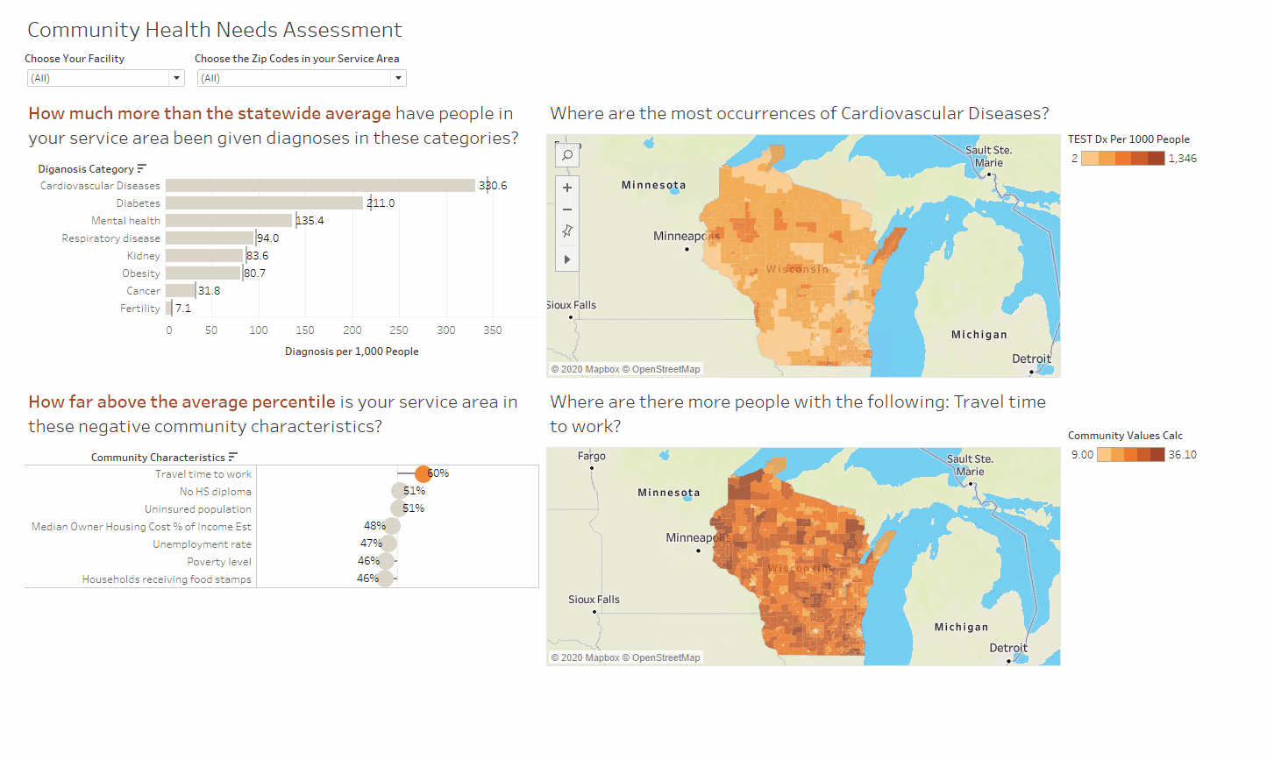
Community Health Needs Assessment Map

Slide 18
Getting Value from YOUR Data

Slide 19
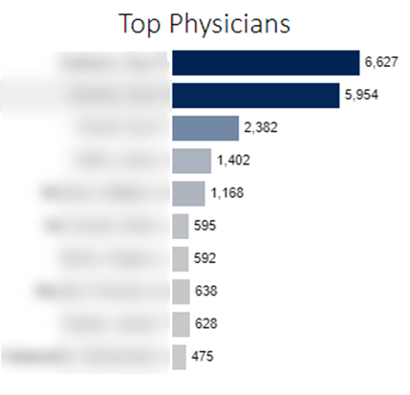
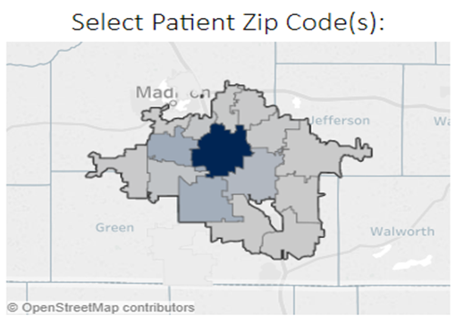
Kaavio: WHAIC’s Analytics Engine
KAAVIO allows users the ability to drill down further into the data by applying filters and refining parameters to find the answers to key questions within the organization
ASCs can better prepare for the future and project their progress moving forward by having a clear visualization of the data through KAAVIO
ASCs can benefit from market share data in strategic planning and development through trending data and reports
Review of outliers (charges)
Trending data for different principal procedures.
Physician analysis (by utilization, by diagnosis, by procedure)
Notes:
WHAIC developed Kaavio on the Tableau platform. It is WHAIC’s analytics engine and where we build our visualizations. Kaavio, is a self-service analytics and visualization tool that enables users to gain crucial insights into areas such as population health, utilization, patient access, geographic distribution and market share for hospitals and freestanding ambulatory surgery centers and compare them to other facilities based on size or region. I’ll be providing an overview on our tool, and then Derek will walk you through some scenarios to help you understand how to navigate within it to get the data that you need.
First, how can your facility access Kaavio. It is available at no additional cost, as long as your facility is purchasing at our “relational” data level. Your facility can have an unlimited number of users. Your facility will need to complete a data use agreement.
Here are just a few examples of how you can use Kaavio. Users can drill down into the data by applying filters to discover historic trends in services at your facility and your peers. You can analyze market share by using built in border maps and we have even included links to US Census Bureau information. There are box and whisker charts to identify outliers, and all of this as you compare with your peer or group of peers, which you select.
In addition to querying the data for services, you can even get to the physician level – how many procedures are your physicians providing? Where are patients coming from to determine reach and patient load? You can do all of this in Kaavio with ease.

Slide 20
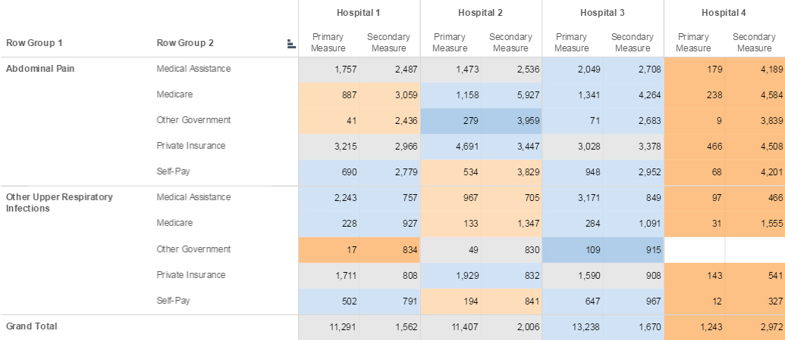
Kaavio: WHAIC’s Analytics Engine
Allows Users to:
• transform data into powerful visualizations that can expose patterns, trends and correlations
• turn data into actionable insights for timely & reliable decision-making

Slide 21
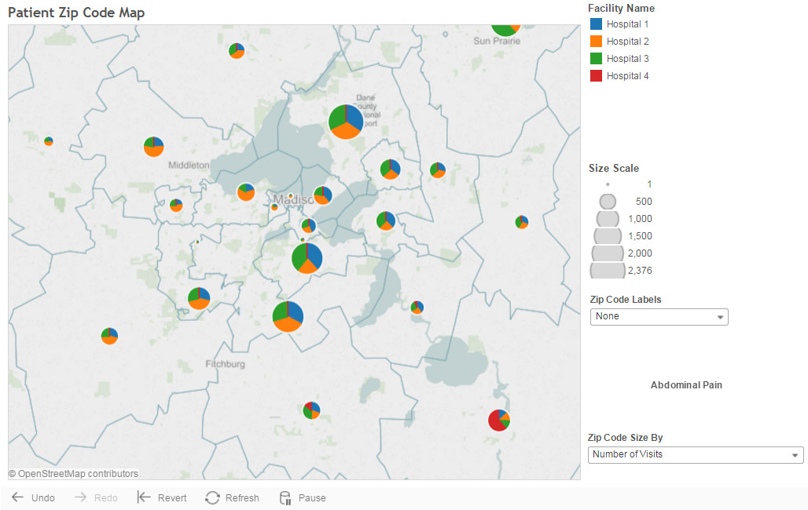
• Empowers analysts with the capabilities they need to meet your organization’s analytic needs
• Users can evaluate health care services, patient populations, utilization, staffing, financial and market performance and much more
• Create/share visual representations of the data for clearer communication with your health care stakeholders

Slide 22
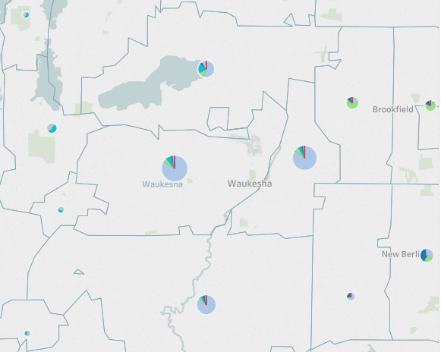
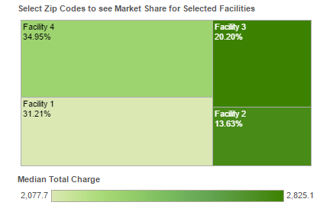
Market Share Analysis
ASCs can benefit from market share data in strategic planning and development through trending data and reports

Slide 23
ASC Dashboard Project
ASC Summary
Top Principal Procedures
Facility Visits
Peer comparison of visits and charges for selected hospitals including three years of trending data
Breakdown of payer types for primary hospital with comparison of all ASCs
Outlines the top 15 procedure codes for the primary hospital, All ASCs and All OPS.
User has the ability to analyze median charges or total visits for individual procedures
Allows for trending analysis of selected procedures
Provides a detailed county utilization map highlighting the highest volume counties
Detailed breakdown shows the individual procedures for the primary facility for each county
Shows the highest number of visits by facility and county
Notes:
WHA Information Center has worked with your WISCA board back om 2018 to made available to all of its members, 3 dashboards. There has been no charge for you to access these and we have agreed to keep them out there for you ever since. (sadly, we have not had very high usage, so we are back to talk about it again ☺)We want you to go out there and see how valuable the data is and if interested, work with us in the Information Center to get you your data and access to Kaavio! I’m going to show you the existing dasbhoards and then I’m going to turn it over to Derek to show you an exciting new much more user-friendly dashboard that we are still going to make available to you, for free, as a WISCA member benefit…and we are looking for your feedback!

Slide 24
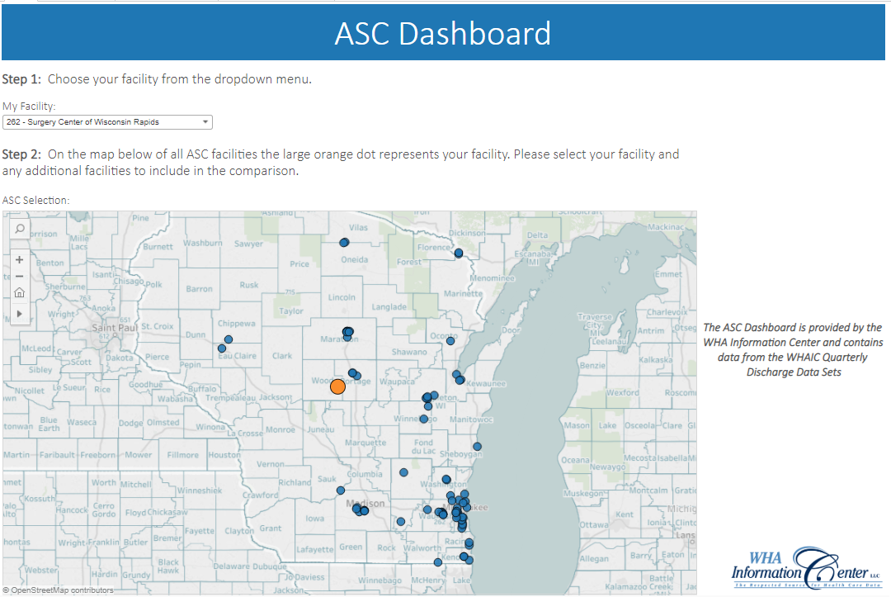

Slide 26
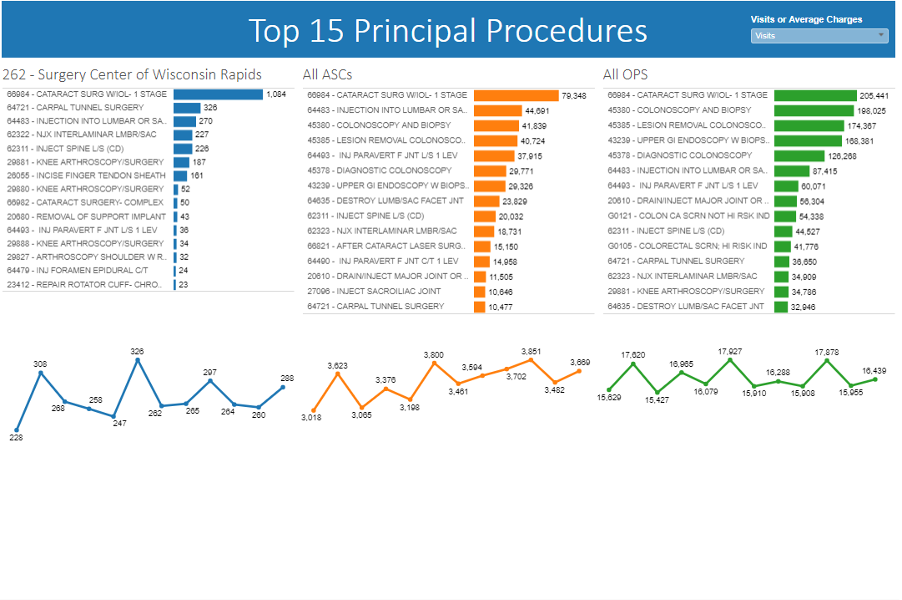

Slide 27
All this is changing…
for the better…

Slide 28
Thank you! You can find more information online at
www.whainfocenter.com
Or contact me (Jennifer Mueller):
jmueller@wha.org
608-268-1805

